Slide 1
Track & Field Meet Server
Phase 2 Presentation
Tracy Marshall

Slide 2
Agenda
Action Items
Requirements Specification
Architecture Design
Test Plan
Technical Inspection Checklist
Risks
Future Plans
Architecture Prototype Demo
Questions and Comments

Slide 3
Action Items
Updates to minor clerical errors in project plan and vision document
Investigate Raspberry Pi performance testing using JMeter

Slide 4
Requirements Specification
Partial Development with USE
Database Classes
Users
Teams
Events
Results
Status
Associations and Constraints

Slide 5
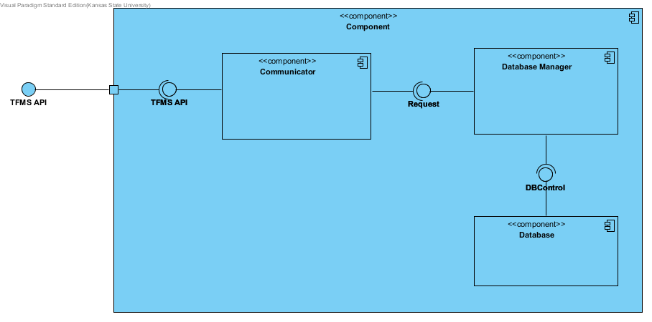
Architecture Design

Slide 6
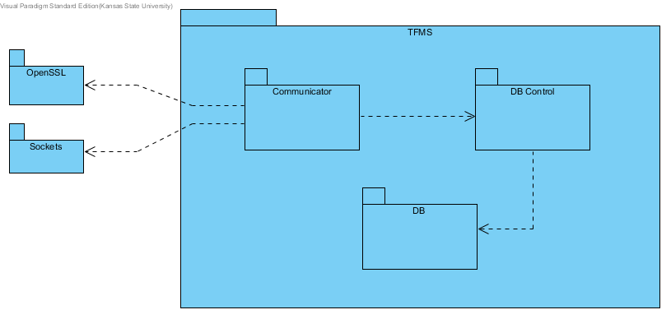
Architecture Design

Slide 7
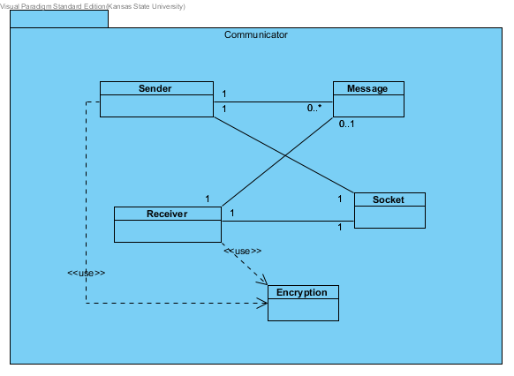
Architecture Design

Slide 8
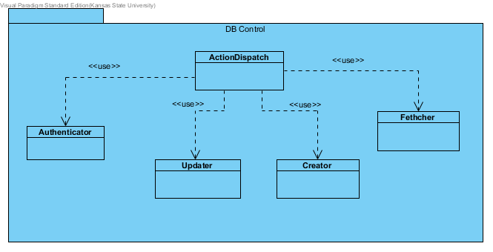
Architecture Design

Slide 9
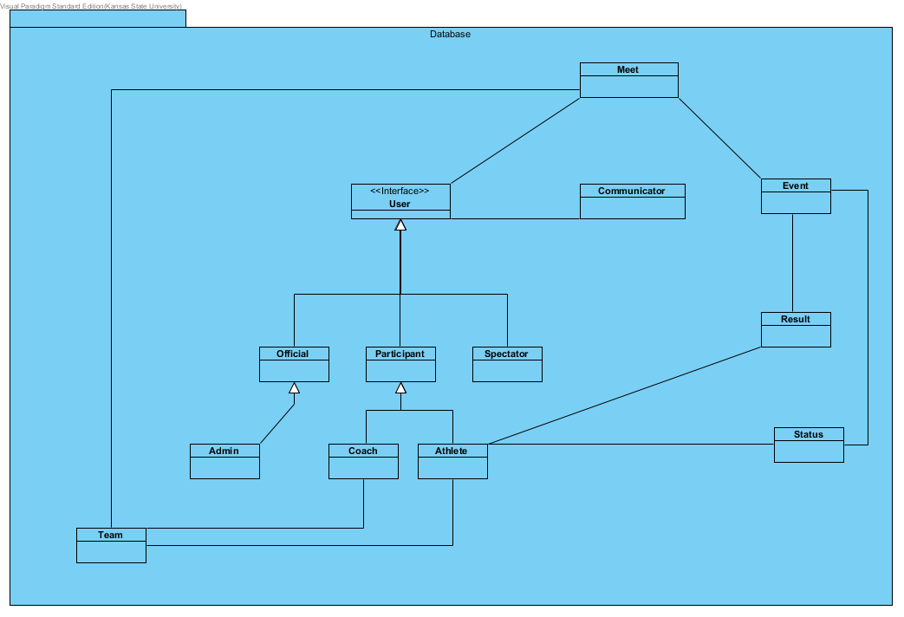
Architecture Design

Slide 10
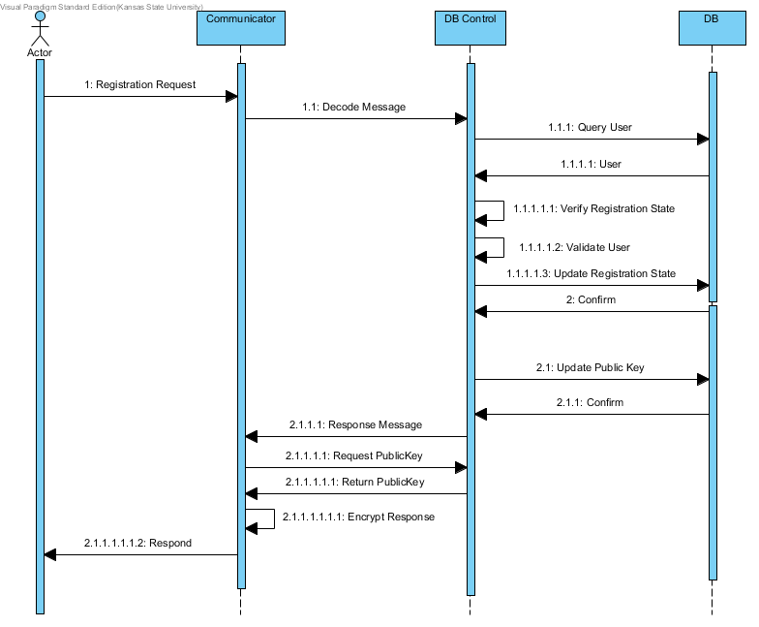
Architecture Design
Registering User

Slide 11
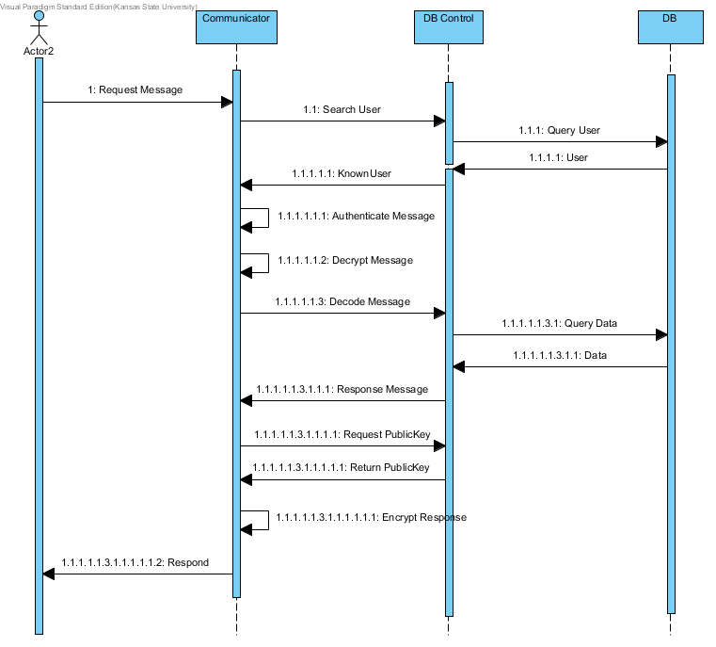
Architecture Design
Requesting Data

Slide 12
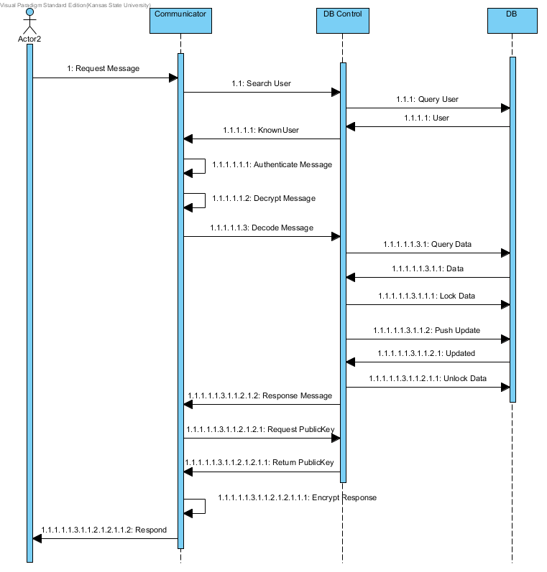
Architecture Design
Updating Data

Slide 13
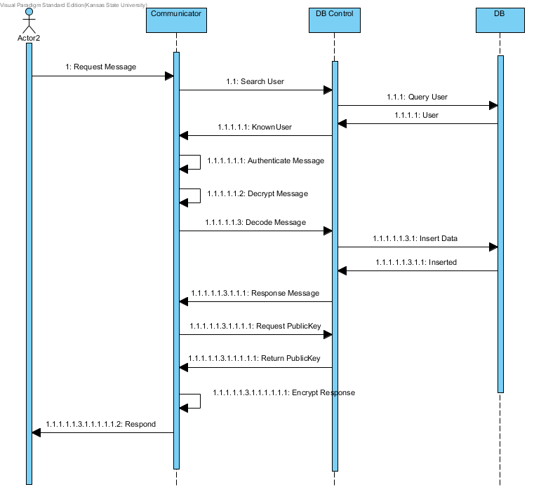
Architecture Design
Adding Data

Slide 14
Test Plan
SR1.1
The system SHALL authenticate users with each interaction they have with the system.
SR2.1
The system SHALL receive data requests from concurrent users.
SR3.1
The system SHALL interpret user requests based on the API.
SR4.1
The system SHALL send response messages to the users.
SR5.1
The system SHALL receive data submittals from official and admin users based on the API.
SR6.1
The system SHALL put submitted data into the system.
SR7.1
The system SHALL add data to the system that is submitted by officials.
SR8.1
The system SHALL modify data in the system that is submitted by administrators.
SR9.1
The system SHALL store a status that is reported by a participant or official.

Slide 15
Test Plan
Philosophy
Black Box Testing
Functional testing to meet requirements
5 Scenarios for requirements coverage

Slide 16
Test Plan
Test Case | Scenario | Features Tested | Passing Criteria
1 | Enter data into server | All Features | Administrators data that they request to add ends up in the database and other users are unable to add data
2 | Modify data | All Features | Modifications to requested data are made when an administrator sends the request but for no other users
3 | Submit Data | All Features | Officials submitted data is accessible to other users and non-officials get rejected
4 | Report Status | All Features | Athletes status update reflects the status that they send and coaches and officials can update the status of athletes that either belong to their team or event respectively. Other users status updates are rejected.
5 | User Authentication | All Features | Users that the system knows about can make requests appropriate to their class and unknown users are rejected

Slide 17
Test Plan
Deliverables
Test Log
Environment Needs
Target Environment
Simulated Client

Slide 18
Technical Inspection Checklist
Inspection Item | Pass/Fail/Partial | Comments
Code readability
Code documentation and comments
Code Structure
Common coding practices
Modular decoupled code
Code functionality
Code maintainability
Security
Code efficiency
Inspection of prototype code
Inspectors
Blake Knedler
Keith Moyer

Slide 19
Risks

Slide 20
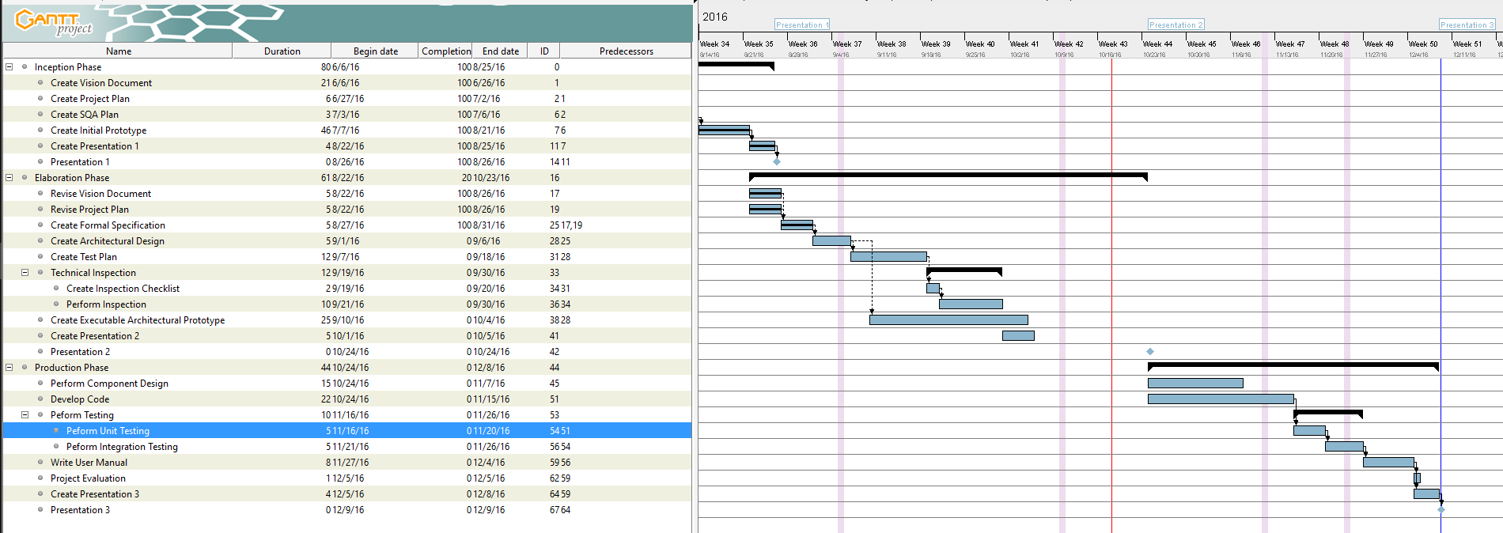
Future Plans

Slide 21
Architecture Prototype Demo

Slide 22
Questions and Comments

Slide 23
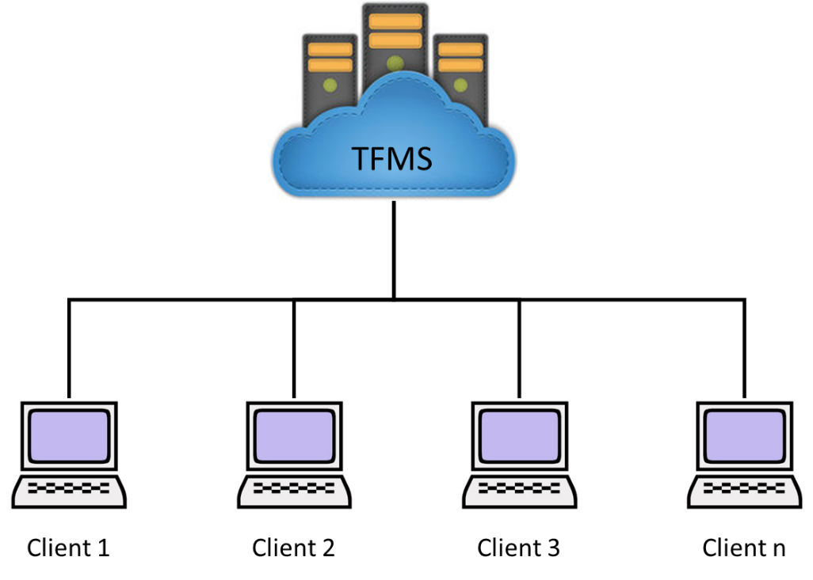
Project Overview
Track & Field Meet Server
Capability to support function of hosting a Track Meet
Repository for all meet data
API to add, manipulate, and view data
Unique user classifications
Supports authentication and encryption to prevent tampering of data

Slide 24
Project Overview
Goals
Create a fully functional server that supports clients of different user classifications
Create a rich API that gives developers the ability to create functional client applications
Create a system that is safe from malicious attackers, attempting to manipulate meet results
Motivation
Leverage today’s technology to increase the efficiency of track meets
Provide a framework that can be built on to advance the future conduct of track meets

Slide 25
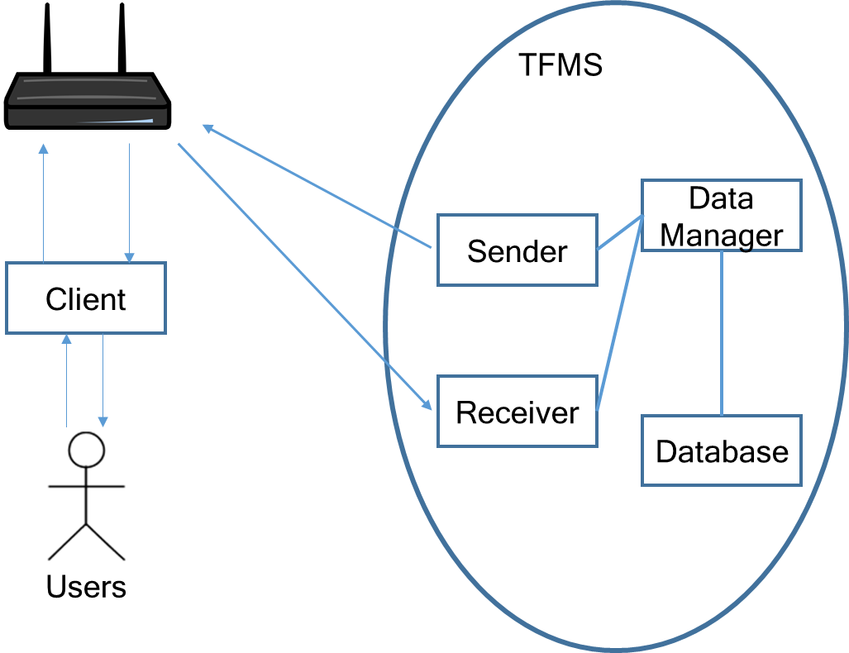
Project Overview

Slide 26
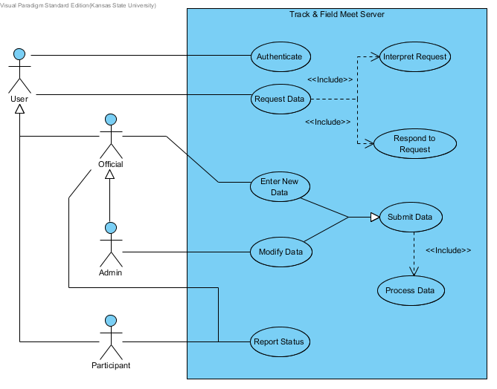
Project Requirements

Slide 27
Project Requirements
SR1.1 The system SHALL authenticate users with each interaction they have with the system.
SR2.1 The system SHALL receive data requests from concurrent users.
SR3.1 The system SHALL interpret user requests based on the API.
SR4.1 The system SHALL send response messages to the users.
SR5.1 The system SHALL receive data submittals from official and admin users based on the API.
SR6.1 The system SHALL put submitted data into the system.
SR7.1 The system SHALL add data to the system that is submitted by officials.
SR8.1 The system SHALL modify data in the system that is submitted by administrators.
SR9.1 The system SHALL store a status that is reported by a participant or official.

Slide 28
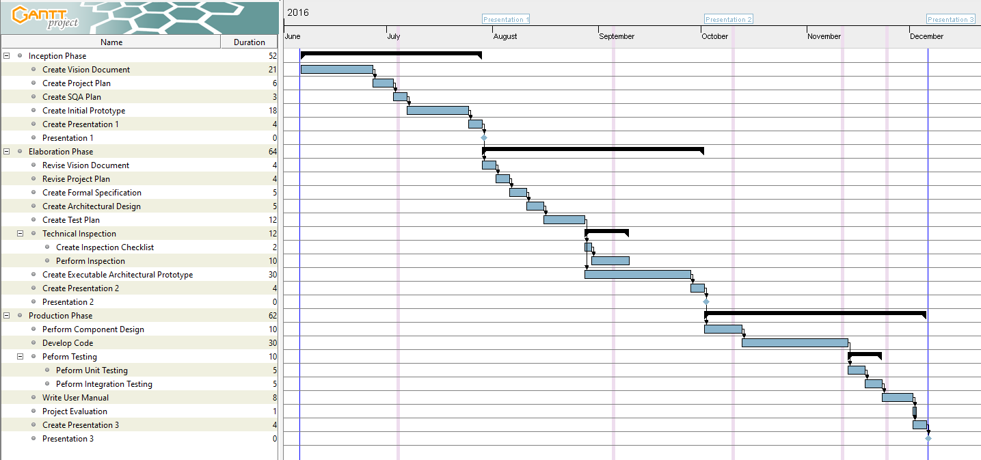
Project Plan

Slide 29
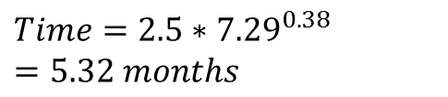
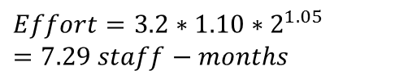
Cost Estimation
Using COCOMO
$$Effort=3.2∗1.10∗2^{1.05}=7.29 staff−months$$
$$Time=2.5∗{7.29}^{0.38}=5.32 months$$

Slide 30
Architecture Elaboration Plan
Revise Vision Document
Revise Project Plan
Create Formal Specification
Create Architectural Design
Create Test Plan
Conduct Technical Inspection
Create Executable Architecture Prototype

Slide 31
Software Quality Assurance Plan
Management
Documentation
Standards, Practices, Conventions, and Metrics
Software Reviews
Testing
Problem Reporting
Tools, Techniques, and Methodologies
Media Control
Risk Management

Slide 32
Risks
Demand on server is not well understood
Performance of Raspberry Pi isn’t full realized
Authentication and Encryption mechanism is not fully determined

Slide 33
Alpha Prototype Demonstration
GitHub Repository Location:
https://github.com/ttmarshall12/KSUMSE
Worked on server/client communication
Explored encryption and authentication models to mitigate risk into development
Able to encrypt and authenticate data sent between server and client

Slide 34
Questions and Comments

